Slide 1
Integração Contínua

Slide 2
O que é?
Integração frequente das diferentes branches de trabalho

Slide 3
CI
Master
CI

Slide 4
TDD
Testes unitários
Testes de Integração
Testes automatizados
Build Testável
Build Contínua
XP
Build automatizada
Várias vezes ao dia
A cada commit (testes e build)
Maior Frequência

Slide 5
Benefícios e Boas Práticas
Build Automática
Build Testável
Commits diários na master
Commits testados e funcionando na master
Build rápida
Deploy Automático

Slide 6
Integração Contínua
Deploy Contínuo
! =

Slide 7
Entrega contínua em produção ao cliente
Deploy Contínuo

Slide 8
Entrega Contínua
(Continuous Delivery)
Deploy Contínuo
! =

Slide 9
Entrega Contínua
(Continuous Delivery)
A habilidade de gerar uma build estável a qualquer momento

Slide 10
Ferramentas

Slide 11








Slide 13



Slide 14
.travis.yml
language: python
python:
- "2.6"
- "2.7"
- "3.2"
- "3.3"
install:
- pip install .
- pip install -r requirements.txt
script: pytest
YAML
Shell-like

Slide 15
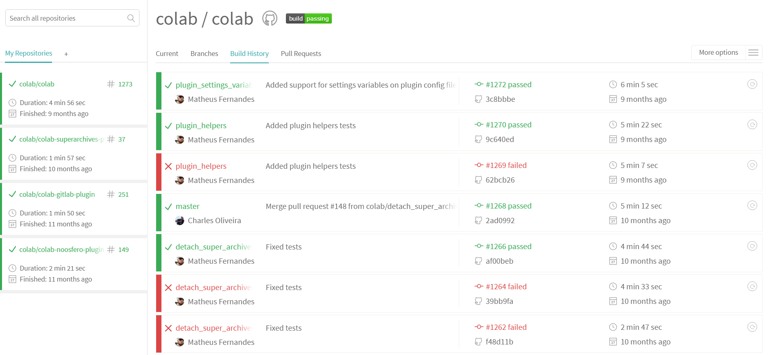

Slide 16
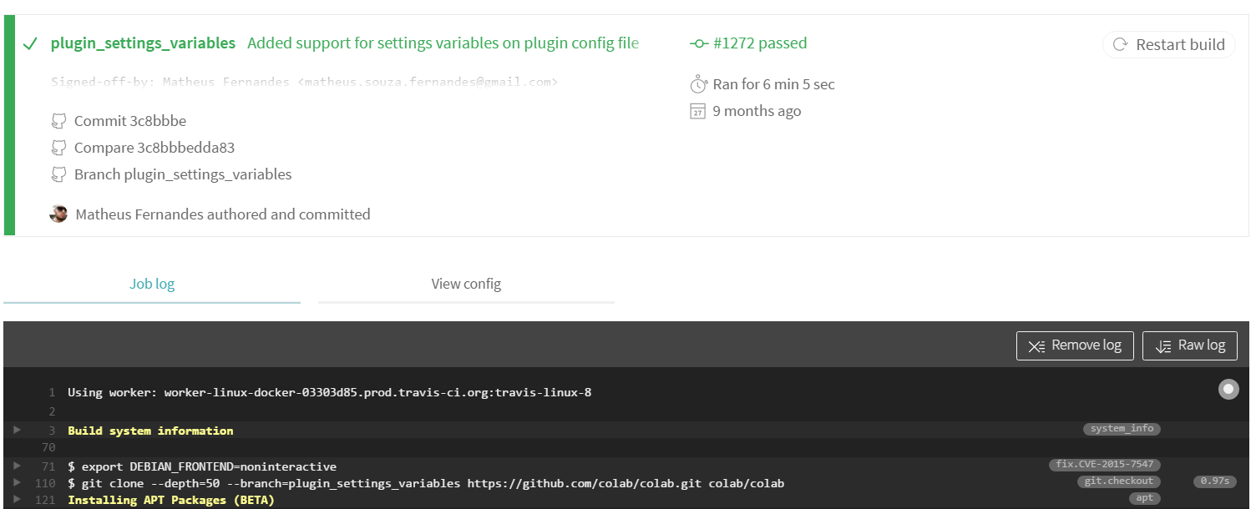

Slide 17
Travis Lifecycle
apt addons
cache components
before install
script
before script
install
before cache
after success
before deploy
after failure
after script
after deploy
deploy

Slide 18

Travis Lifecycle
addons:
apt:
sources:
- ubuntu-toolchain-r-test
packages:
- gcc-4.8
- g++-4.8
- cmake
apt addons
Exclusivo do Ubuntu

Slide 19
Travis Lifecycle
apt addons
Exclusivo do Ubuntu
addons:
apt:
sources:
- deadsnakes
- sourceline: 'ppa:ubuntu-toolchain-r/test'
- sourceline: 'deb https://packagecloud.io/chef/stable/ubuntu/precise main'
key_url: 'https://packagecloud.io/gpg.key'

Slide 20
Travis Lifecycle
apt addons
cache components
before install
script
before script
install
before cache
after success
before deploy
after failure
after script
after deploy
deploy

Slide 21
Travis Lifecycle
Marcar o que deve ser salvo após a build
apt addons
cache components
cache:
- bundler
- cocoapods
cache:
directories:
- $HOME/.cache/pip
cache:
bundler: true
directories:
- node_modules # NPM packages
Evita downloads lentos durante a build

Slide 22
Travis Lifecycle
apt addons
cache components
before install
script
before script
install
before cache
after success
before deploy
after failure
after script
after deploy
deploy

Slide 23

Travis Lifecycle
Install para qualquer SO
apt addons
cache components
before install
before_install:
- sudo apt-get -qq update
- sudo apt-get install -y libxml2-dev
before_install:
- brew update
- brew install beanstalk
before_install:
- wget http://pngquant.org/pngquant_1.7.1-1_i386.deb
- sudo dpkg -i pngquant_1.7.1-1_i386.deb

Slide 24
Múltiplos Sistemas Operacionais
os:
- linux
- osx
10.11.6
Trusty
Precise

Slide 25
Travis Lifecycle
apt addons
cache components
before install
script
before script
install
before cache
after success
before deploy
after failure
after script
after deploy
deploy

Slide 26
Travis Lifecycle
Install dedicado ao projeto
apt addons
cache components
before install
install:
- bundle install --path vendor/bundle
- npm install
install
install: true
install: ./install-dependencies.sh
Pula o install
Deve ter o #!/usr/bin/env sh

Slide 27
Travis Lifecycle
Install dedicado ao projeto
apt addons
cache components
before install
install
install:
- if [ $TRAVIS_OS_NAME = linux ]; then sudo apt-get install foo; else brew install bar; fi

Slide 28
Travis Lifecycle
apt addons
cache components
before install
script
before script
install
before cache
after success
before deploy
after failure
after script
after deploy
deploy

Slide 29
Travis Lifecycle
apt addons
cache components
before install
before script
install
Prepara o ambiente para o script
before_script:
- cp config/database.yml.travis config/database.yml

Slide 30
Travis Lifecycle
apt addons
cache components
before install
script
before script
install
before cache
after success
before deploy
after failure
after script
after deploy
deploy

Slide 31
Travis Lifecycle
apt addons
cache components
before install
script
before script
install
script:
- python setup.py test
- flake8 colab
Onde acontece a build, testes, lint, ...

Slide 32
Status de Retorno
before install
before script
Erro na Build
Falha na Build
script
install

Slide 33
Travis Lifecycle
apt addons
cache components
before install
script
before script
install
before cache
after success
before deploy
after failure
after script
after deploy
deploy

Slide 34
Travis Lifecycle
Acontece antes de salvar o cache
apt addons
cache components
before install
script
before script
install
before cache
cache:
directories:
- $HOME/.cache/pip
before_cache:
- rm -f $HOME/.cache/pip/log/debug.log

Slide 35
Travis Lifecycle
apt addons
cache components
before install
script
before script
install
before cache
after success
before deploy
after failure
after script
after deploy
deploy

Slide 36
Travis Lifecycle
apt addons
cache components
before install
script
before script
install
Build docs, upload cobertura dos testes, ...
before cache
after success
after_success:
- coveralls
after failure
Upload log de erro, ...

Slide 37
Travis Lifecycle
apt addons
cache components
before install
script
before script
install
before cache
after success
before deploy
after failure
after script
after deploy
deploy

Slide 38




Travis Lifecycle
Processo dedicado ao deploy
before deploy
Executa mesmo a build sendo bem ou mal sucedida
after script
after deploy
deploy

Slide 39
Travis Lifecycle
Entrega Contínua
deploy:
provider: heroku
api_key: ...
app:
master: my-app-staging
production: my-app-production
Geração da api_key
travis encrypt $(heroku auth:token) --add deploy.api_key
Processo dedicado ao deploy
before deploy
Executa mesmo a build sendo bem ou mal sucedida
after script
after deploy
deploy

Slide 40
Valiação do arquivo do Travis
Gem Travis
$ travis lint .travis.yml

Slide 41
CI Lifecycle + CD
Controle de Cache
Preparação do env
Build e Test
Monitoramento
Deploy
cache components
before install
script
before script
install
before cache
after success
before deploy
after failure
after script
after deploy
deploy

Slide 45
circleci.yml
YAML
Shell-like
machine:
timezone:
America/Los_Angeles
ruby:
version:
1.8.7-p358-falcon-perf
checkout:
post:
- git submodule sync
- git submodule update --init
dependencies:
pre:
- npm install coffeescript
- gem uninstall bundler
- gem install bundler --pre

Slide 46
Circle CI Lifecycle
machine
checkout
7 seções
Seriais
Independentes
Todas as seções podem falhar a build
0 == sucesso
!0 == falha
dependencies
database
compile
Nunca falha build
test
deployment

Slide 47
Circle CI Lifecycle
Configuração da máquina de build
machine
machine:
timezone:
America/Los_Angeles
ruby:
version: 1.9.3-p0-falcon
hosts:
dev.circleci.com: 127.0.0.1
foobar: 1.2.3.4
environment:
foo: bar
baz: 123
services:
- cassandra
- elasticsearch
- rabbitmq-server
- redis

Slide 48
Circle CI Lifecycle
machine
checkout
Obter o código no seu estado correto
checkout:
post:
- git submodule sync
- git submodule update --init
Pode se utilizar o default

Slide 49
Circle CI Lifecycle
machine
Instalar as dependências do projeto
checkout
dependencies:
pre:
- gem uninstall bundler
- gem install bundler --pre
override:
- npm install
cache_directories:
- "assets/cache"
- "~/assets/output"
dependencies
Sobrescrever o padrão

Slide 50
Circle CI Lifecycle
machine
Configuração do banco de dados
checkout
database:
override:
- mv config/database.ci.yml config/database.yml
- bundle exec rake db:create db:schema:load --trace
dependencies
database

Slide 51
Circle CI Lifecycle
machine
Comandos para uma build customizada
checkout
dependencies
compile:
override:
- bundle exec middleman build --verbose
test:
override:
- phpunit my/special/subdirectory/tests
database
compile
test

Slide 52
Circle CI Lifecycle
machine
checkout
deployment:
staging:
branch: master
heroku:
appname: foo-bar-123
dependencies
database
compile
Opicional
Faz o deploy para um provider
1+ branches especificadas
SSH keys registradas no CircleCI
test
deployment

Slide 53
machine
cache components
before install
checkout
script
before script
install
dependencies
before cache
after success
before deploy
database
after failure
compile
after script
after deploy
deploy
test
deployment

Slide 54
Perguntas?

